Slide 1
Neural Networks Basics
Author:
Yan-yang Lee(blamedrlee@outlook.com)

Slide 2
Prerequisites
Basic Calculus(derivatives, Taylor Series and etc.)
Basic Probability(random variable, distributions and etc.)
Basic Linear Algebra(matric arithmetic, decompositions and etc.)
(Optional)Machine Learning Basics

Slide 3
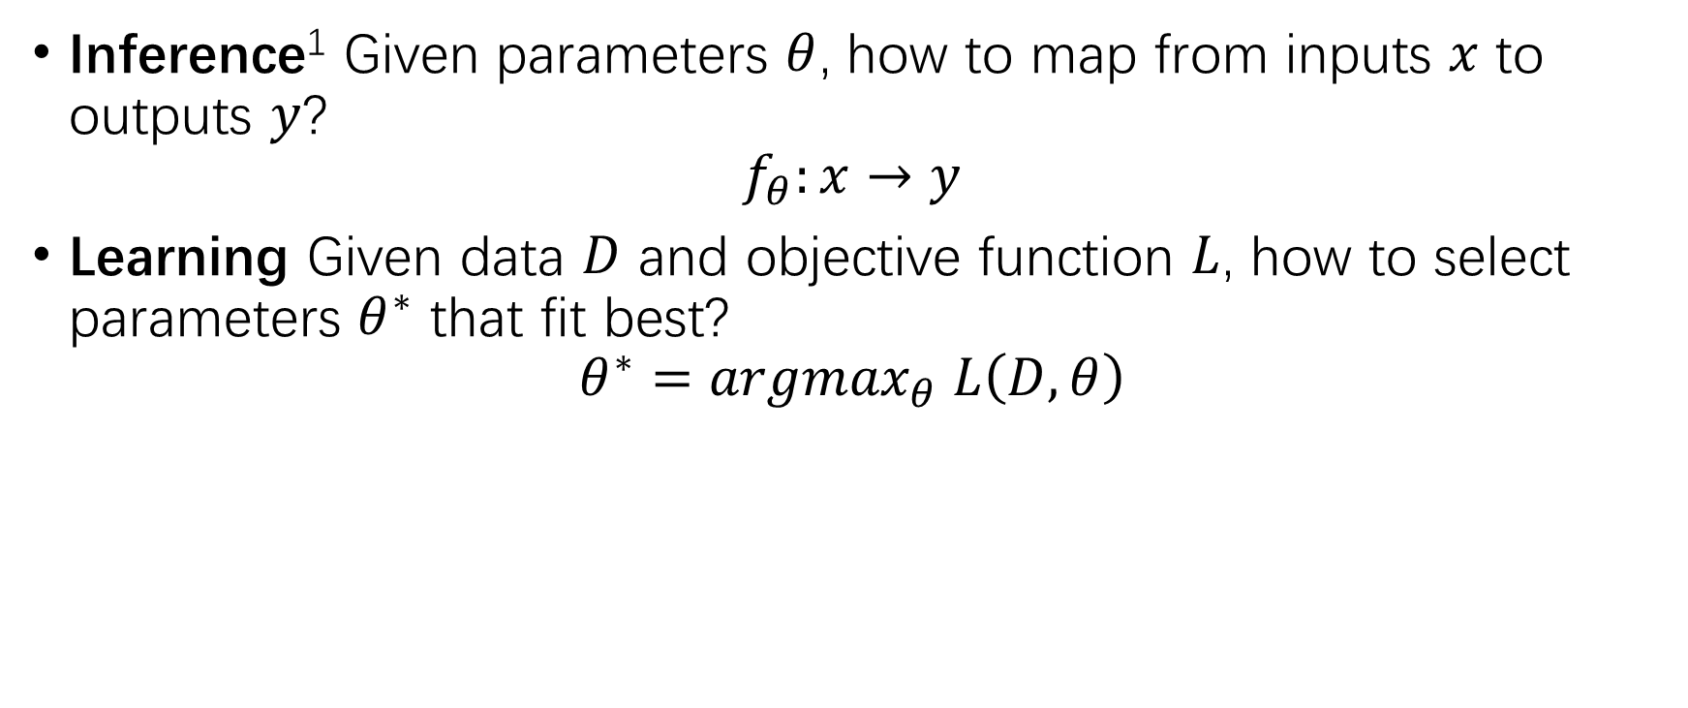
Two Main Tasks for Neural Networks
Inference¹ Given parameters $θ$, how to map from inputs $x$ to outputs $y$?
$$f_{θ}:x→y$$
Learning Given data $D$ and objective function $L$, how to select parameters $θ^{∗}$ that fit best?
$$θ^{∗}={argmax}_{θ} L\left(D,θ\right)$$

Slide 4
Multi-layers Perceptron(MLP)
MLP is the first type of Neural Networks and had a very long history
MLP is also called “feedforward neural network”
MLP is nothing more than stacked simple computations
Essentially any kind of (Directed) Neural Network is a special forms of MLP

Slide 5
Contents
MLP Structure: P6
Forward Propagation(Inference): P7
Unfold Cyclical Connections: P8
Activation Functions: P9-17
Priors/Assumptions: P17-21
Representation Power: P22-24

Slide 6
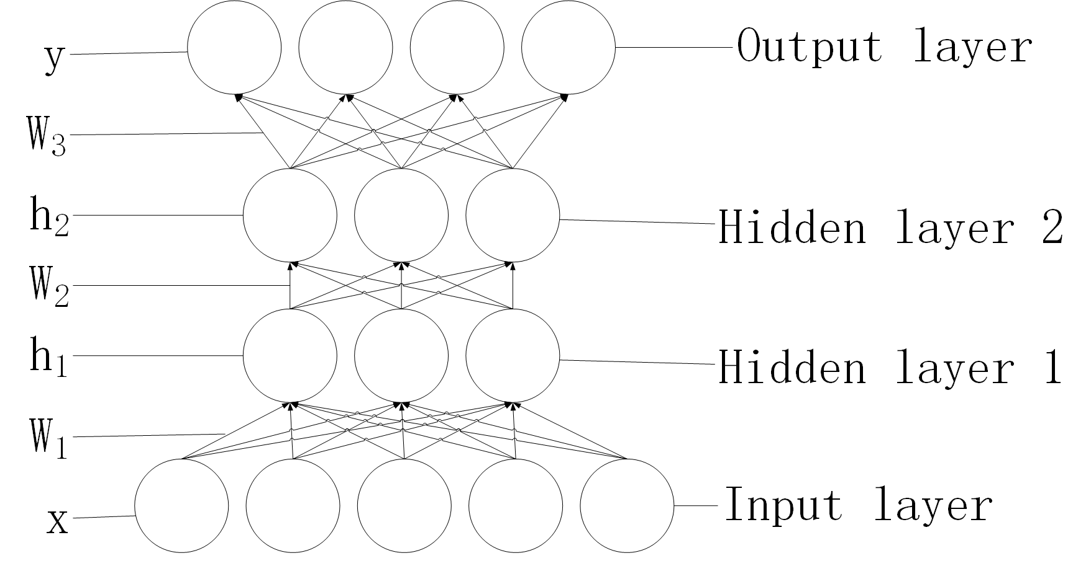
MLP Structure

Slide 7
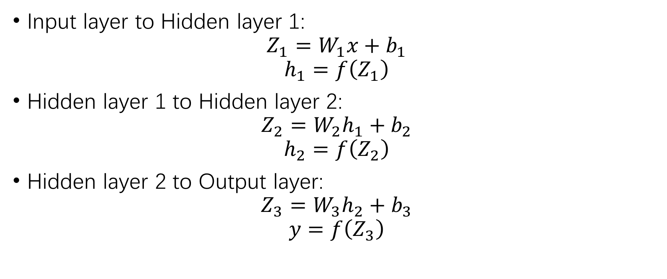
Forward Propagation
Input layer to Hidden layer 1:
$$Z_{1}=W_{1}x+b_{1}$$
$$h_{1}=f\left(Z_{1}\right)$$
Hidden layer 1 to Hidden layer 2:
$$Z_{2}=W_{2}h_{1}+b_{2}$$
$$h_{2}=f\left(Z_{2}\right)$$
Hidden layer 2 to Output layer:
$$Z_{3}=W_{3}h_{2}+b_{3}$$
$$y=f\left(Z_{3}\right)$$

Slide 8
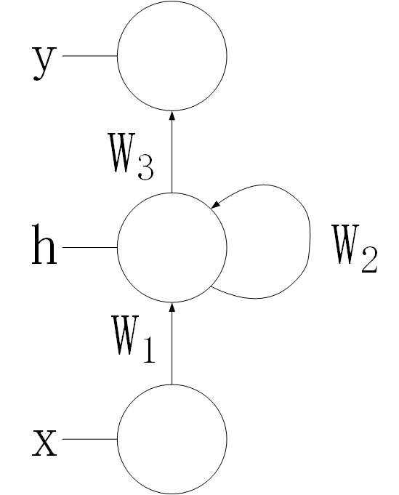
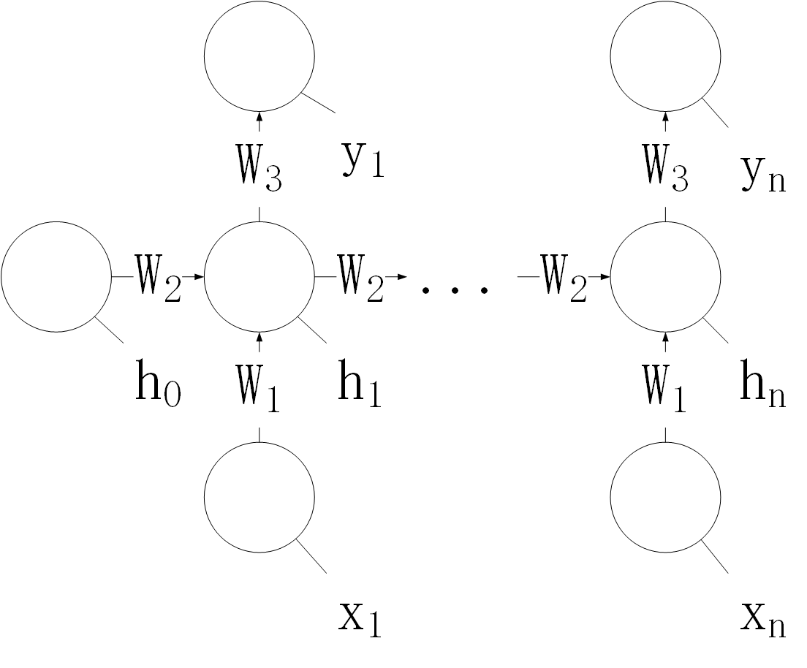
Unfold Cyclical Connections
RNN
Unfolded RNN

Slide 9
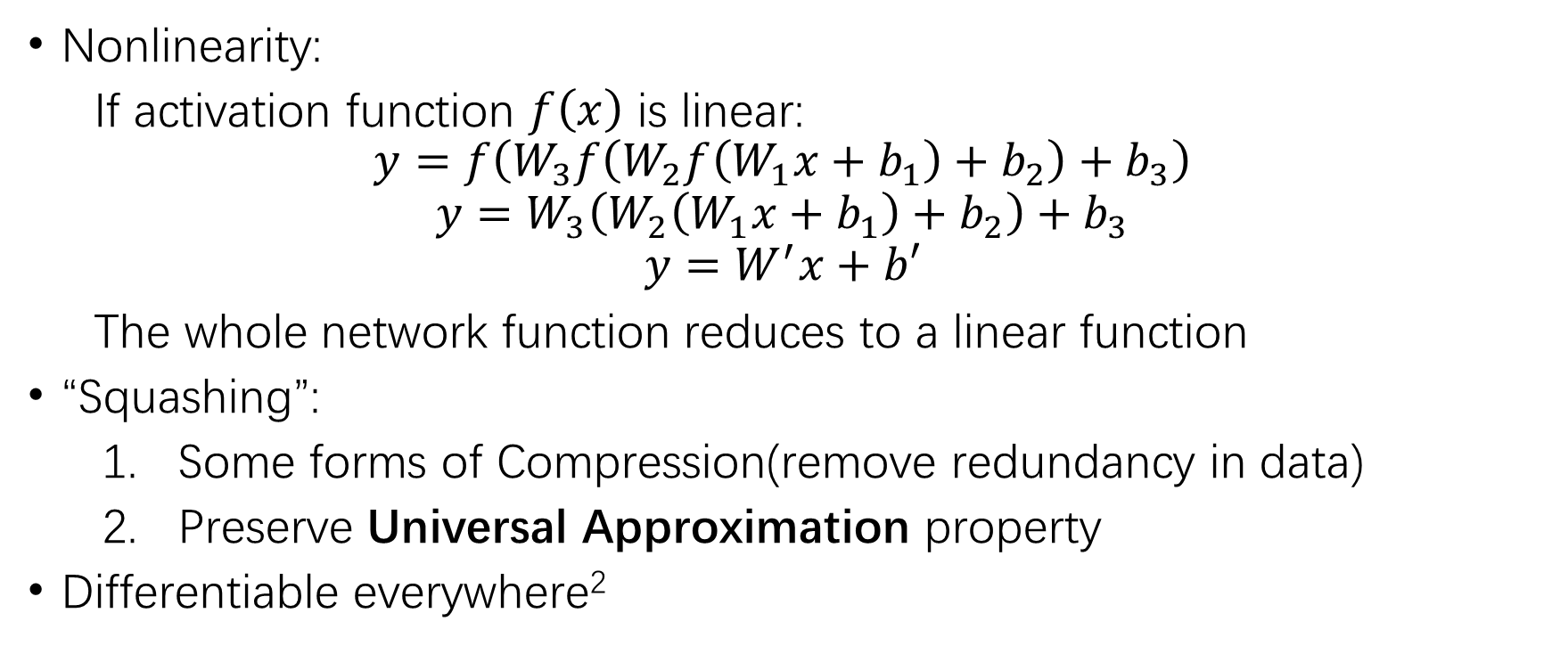
Requirements for Activation Functions
Nonlinearity:
If activation function $f\left(x\right)$ is linear:
$$y=f\left(W_{3}f\left(W_{2}f\left(W_{1}x+b_{1}\right)+b_{2}\right)+b_{3}\right)$$
$$y=W_{3}\left(W_{2}\left(W_{1}x+b_{1}\right)+b_{2}\right)+b_{3}$$
$$y=W^{′}x+b′$$
The whole network function reduces to a linear function
“Squashing”:
Some forms of Compression(remove redundancy in data)
Preserve Universal Approximation property
Differentiable everywhere²

Slide 10
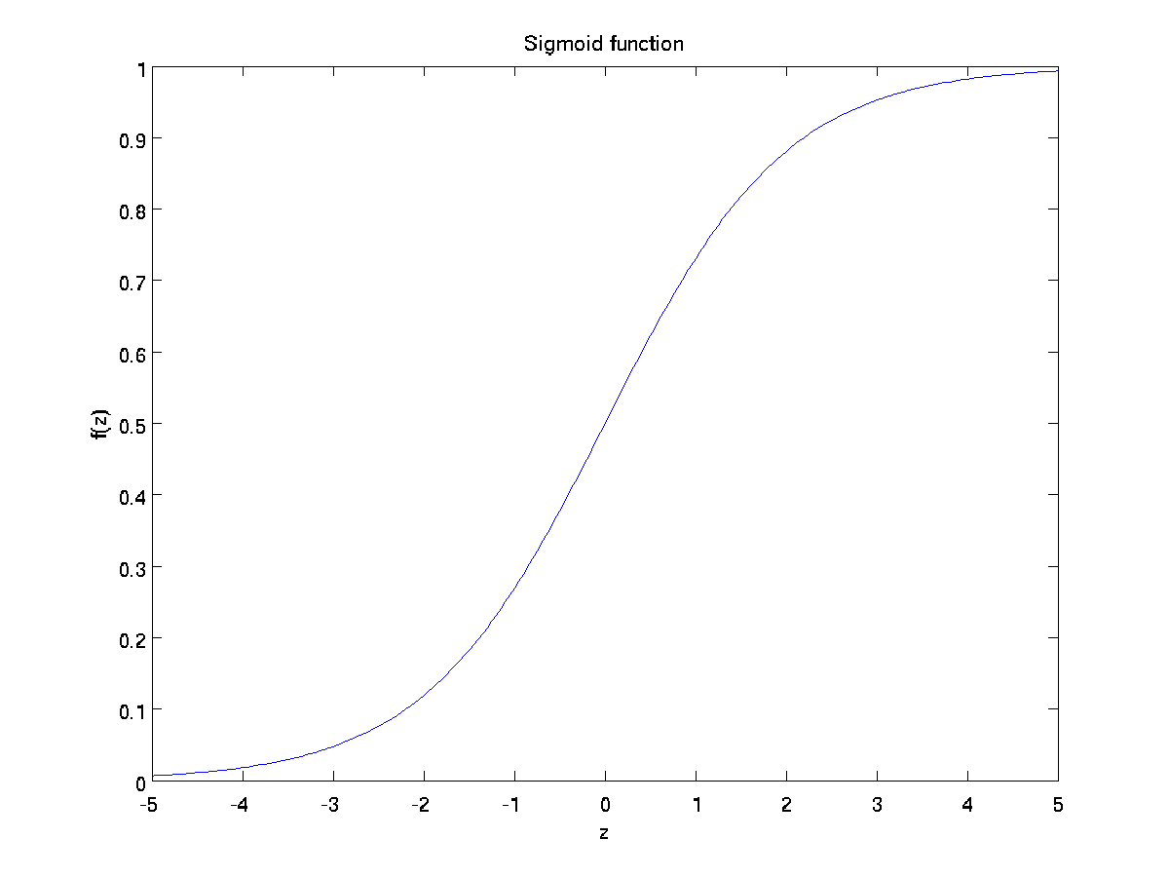
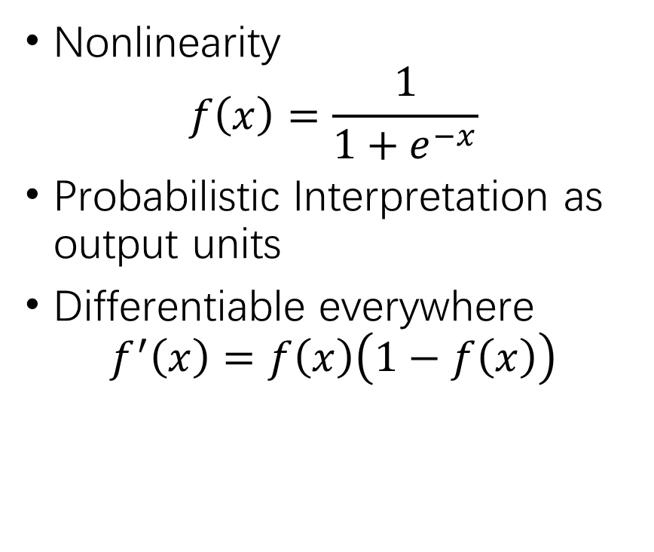
Activation Function – Sigmoid/Logistic
Nonlinearity
$$f\left(x\right)=\frac{1}{1+e^{−x}}$$
Probabilistic Interpretation as output units
Differentiable everywhere
$$f^{′}\left(x\right)=f\left(x\right)\left(1−f\left(x\right)\right)$$

Slide 11
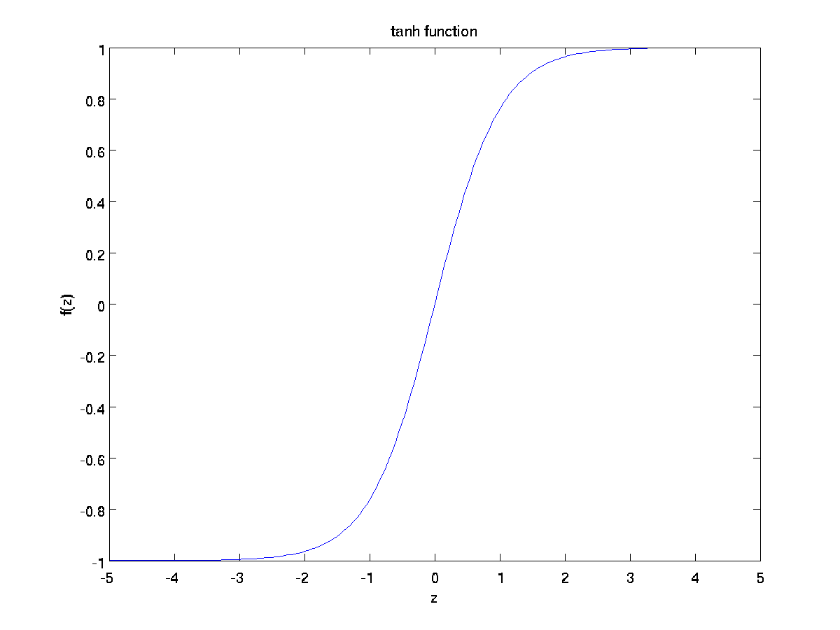
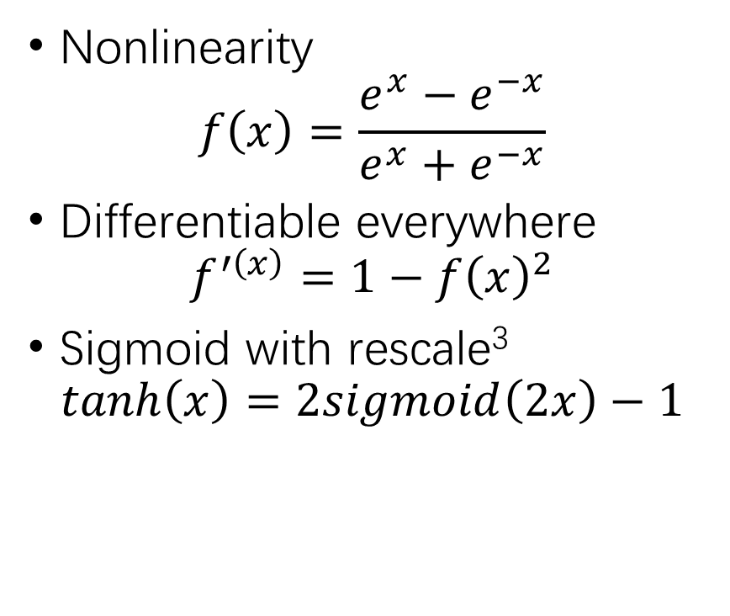
Activation Function - Tanh
Nonlinearity
$$f\left(x\right)=\frac{e^{x}−e^{−x}}{e^{x}+e^{−x}}$$
Differentiable everywhere
$$f^{′\left(x\right)}=1−{f\left(x\right)}^{2}$$
Sigmoid with rescale³
$$tanh\left(x\right)=2sigmoid\left(2x\right)−1$$

Slide 12
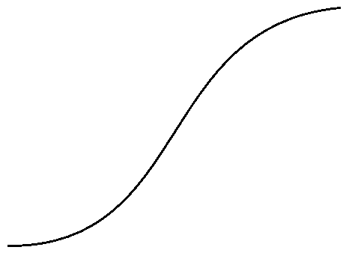
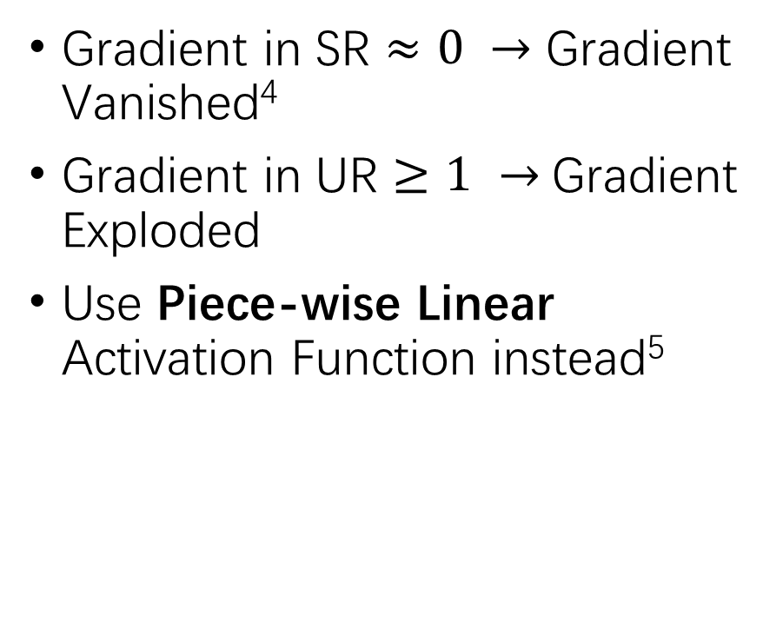
Analysis of S-shaped Curve
Gradient in SR $≈0 →$ Gradient Vanished⁴
Gradient in UR $≥1 →$Gradient Exploded
Use Piece-wise Linear Activation Function instead⁵
Saturated Regime
(near constant)
Unsaturated Regime
(near linear)

Slide 13
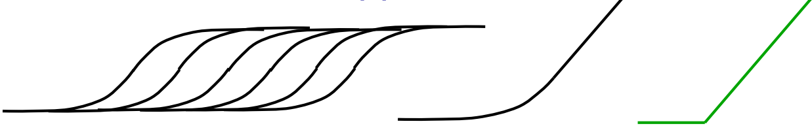



Activation Function - ReLU
Gradient = 0 or 1
i.e., no Gradient Vanished/Exploded
i.e., speed up learning⁶
Softplus
ReLU
$$\int_{−∞}^{x}{sigmoid\left(u\right)du}$$
$$log\left(1+e^{x}\right)$$
$$max\left(0,x\right)$$

Slide 14
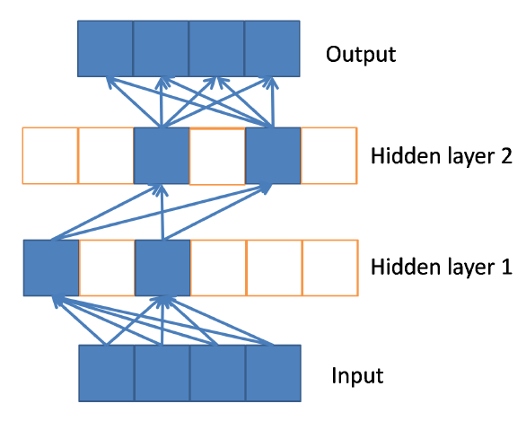
Nonlinearity of ReLU⁷
Activate different subsets of units for different inputs
Equivalent to different linear functions for different inputs
There are exponential number of possible linear functions which shared parameters

Slide 15
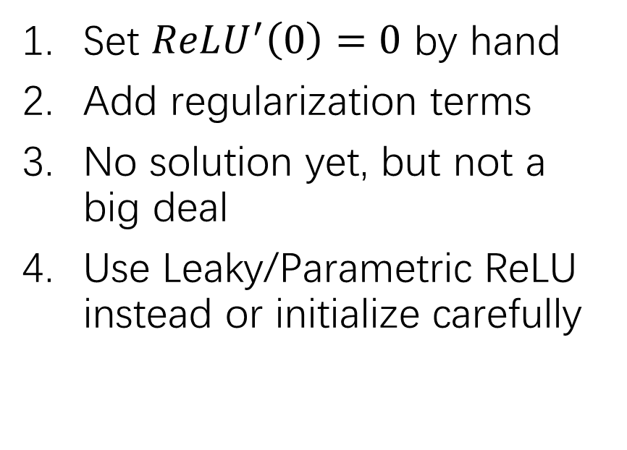
Analysis of ReLU
Drawbacks
Remedies
Non-differentiable at 0
Unbounded output
Identical network function if biases and weights are scaled with a particular way
“Dead”⁸ units stay “dead”
Set $ReLU^{′}\left(0\right)=0$ by hand
Add regularization terms
No solution yet, but not a big deal
Use Leaky/Parametric ReLU instead or initialize carefully

Slide 16
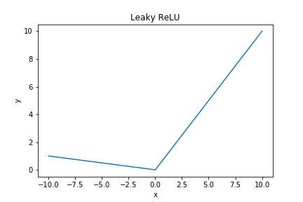
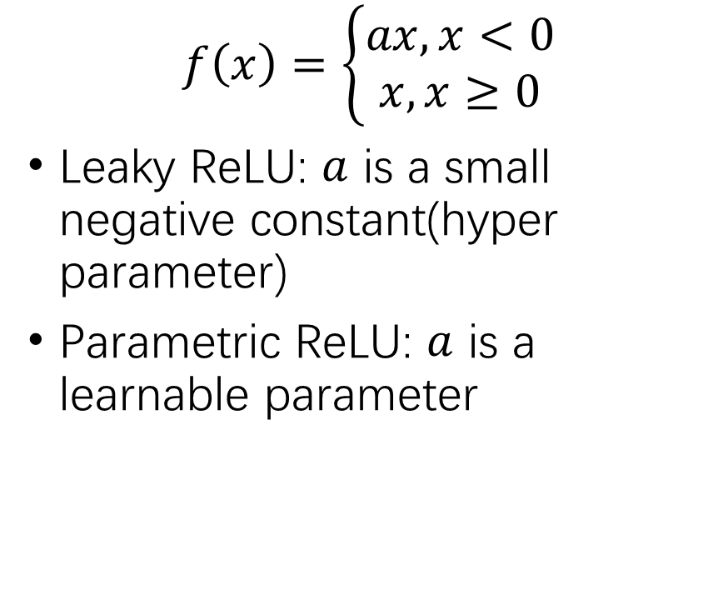
Leaky/Parametric ReLU
$$f\left(x\right)=\left\{\begin{aligned}ax,x<0 \\ x,x≥0\end{aligned}\right.$$
Leaky ReLU: $a$ is a small negative constant(hyper parameter)
Parametric ReLU: $a$ is a learnable parameter

Slide 17
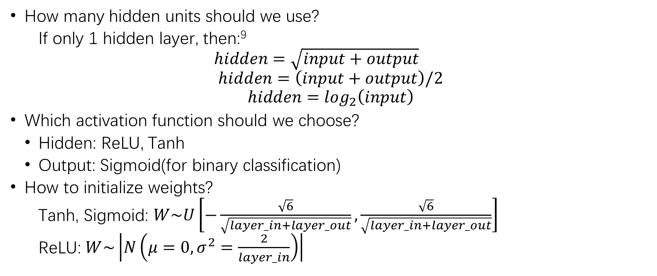
Tips
How many hidden units should we use?
If only 1 hidden layer, then:⁹
$$hidden=\sqrt{input+output}$$
$$hidden=\left(input+output\right)/2$$
$${hidden=log}_{2}\left(input\right)$$
Which activation function should we choose?
Hidden: ReLU, Tanh
Output: Sigmoid(for binary classification)
How to initialize weights?
Tanh, Sigmoid: $W\sim U\left[−\frac{\sqrt{6}}{\sqrt{layer_in+layer_out}},\frac{\sqrt{6}}{\sqrt{layer_in+layer_out}}\right]$
ReLU: $W\sim \left|N\left(μ=0,σ^{2}=\frac{2}{layer_in}\right)\right|$

Slide 18
Prior/Assumptions¹⁰
Explanatory factors Hierarchy Hypothesis In principle, factors that can explain variance of data are defined in term of each other. For abstract concepts, they are composed of simple detailed concepts.
Manifolds Hypothesis Probability mass concentrate in a locally connected regions occupied only a tiny volume, which can be approximated by a low-dimensional manifolds with a much smaller dimensionality than the original space where data lives

Slide 19
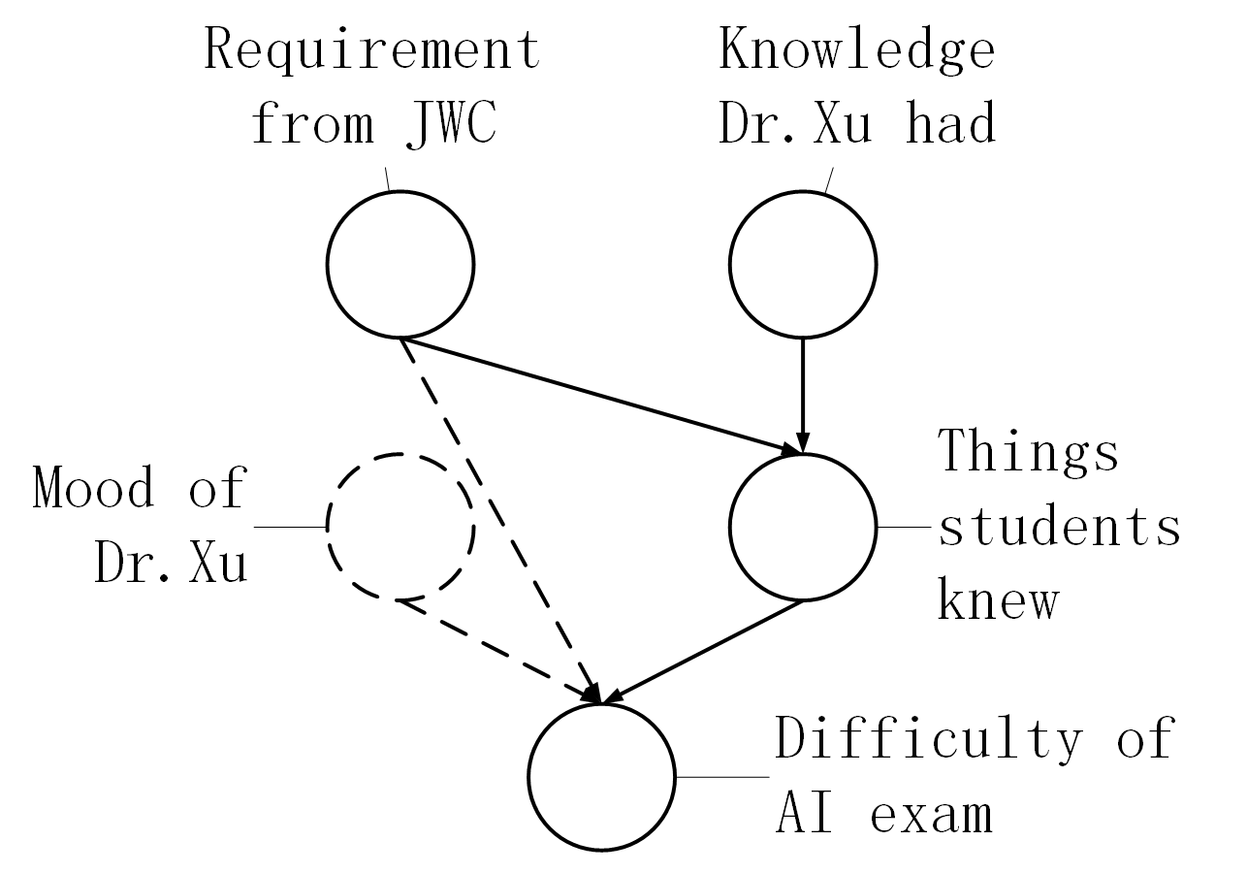
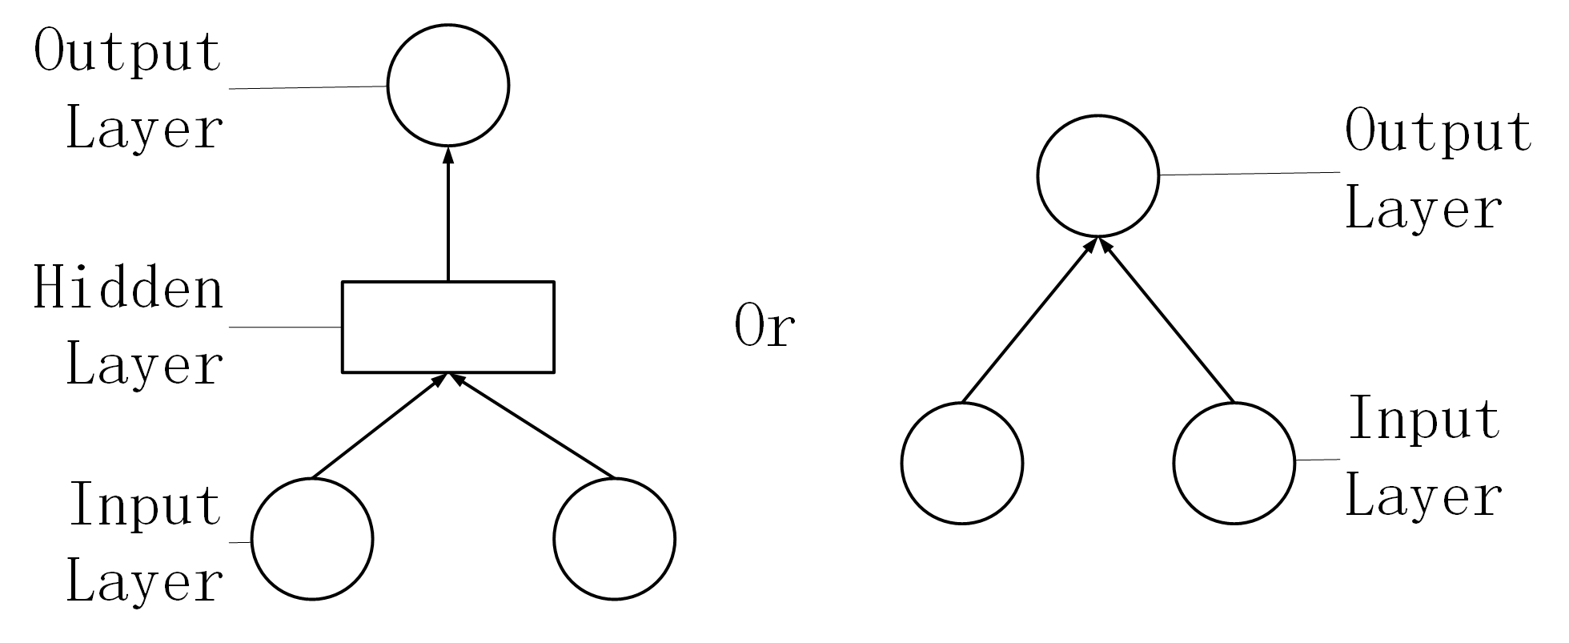
Hierarchy Hypothesis
Why?¹¹
How?¹²

Slide 20
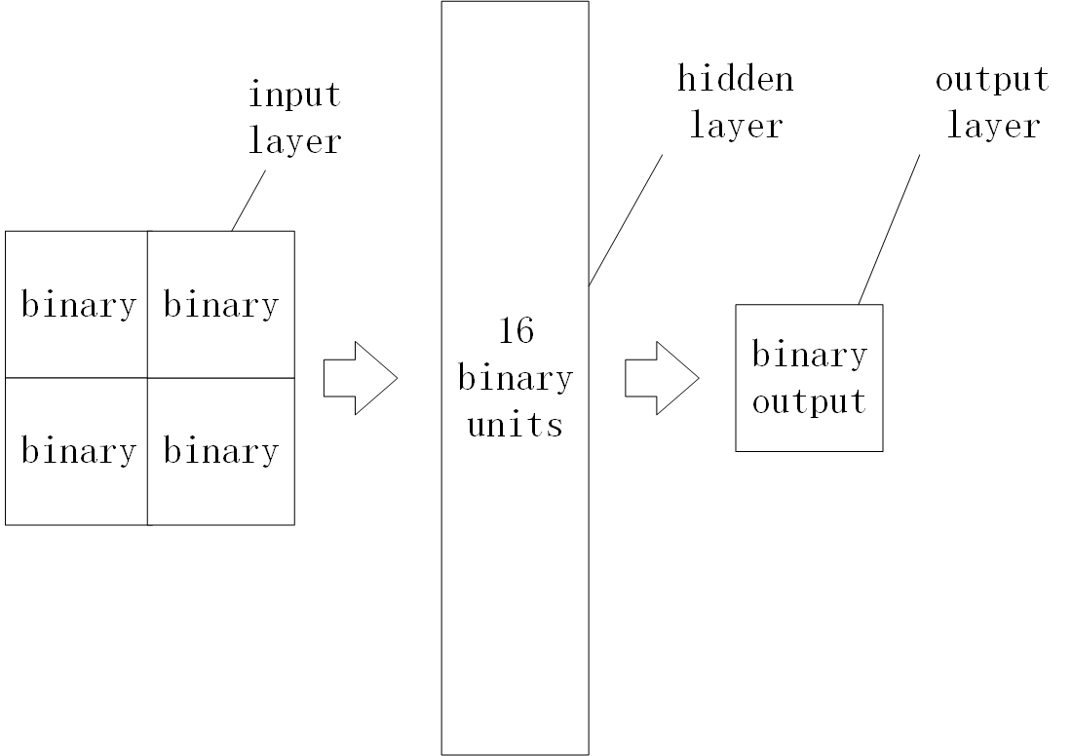
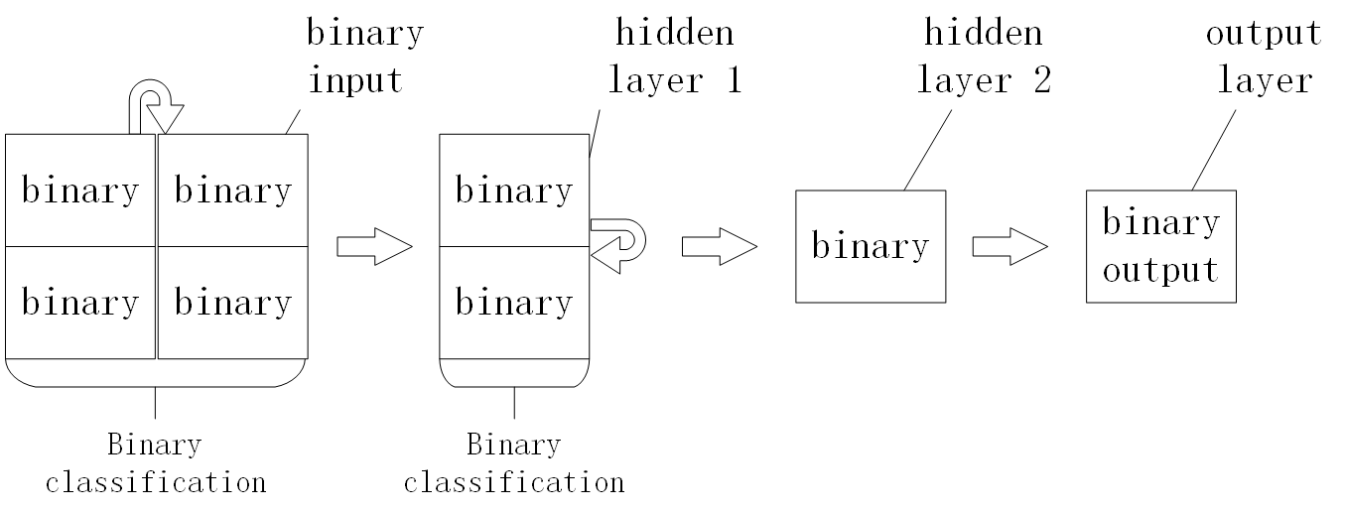
Go deeper, More efficient¹³
1 hidden layer MLP
2 hidden layer MLP

Slide 21
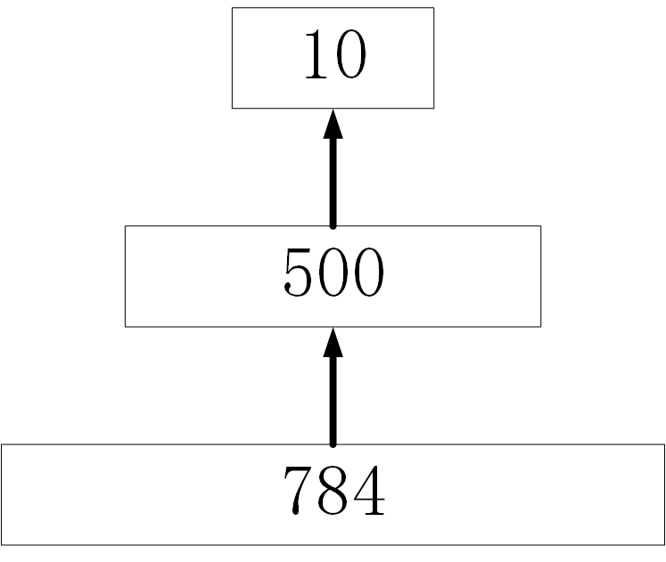
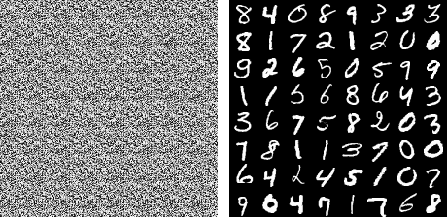
Manifolds Hypothesis¹⁴
Why?¹⁵
How?¹⁶

Slide 22
Representation Power
Universal Approximation Theorem a feedforward network with a linear output layer and at least one hidden layer with any “squashing” activation function can approximate any continuous function from one finite-dimensional space to another with any desired non-zero amount of error, provided that the network is given enough hidden units¹⁷
It is naturally satisfied by MLP in regression problems
It is also satisfied by MLP in classification problems by transforming them into a probability distribution prediction problem¹⁸

Slide 23
Limitations of MLP
No universal learning algorithm(implied by No Free Lunch Theorem)¹⁹
Not efficient²⁰
Not a function²¹

Slide 24
Observations from Other Domains
Godel’s Incompleteness Theorem²²
The Halting Problem²³
MLP may not necessarily be a General AI model for every problem!²⁴

Slide 25
Assignment
Read Chapter 6, 15 of Deep Learning, Goodfellow et al., 2016.
Derive derivative of Sigmoid
Hand in lecture notes

Slide 26
Thank you!
Send me emails for potential mistakes.

